Slide 1
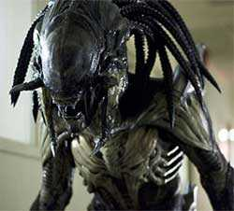
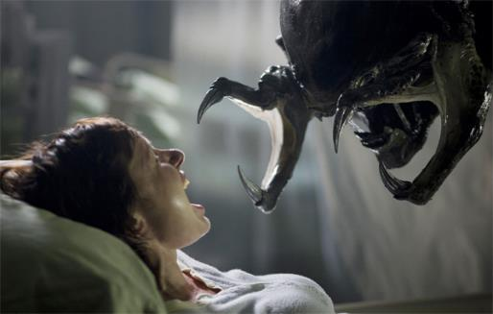
Predator vs Prey
Final Project
By: Ronney Aovida

Slide 2
Background
wolves vs moose
Prediction: the ecologist predicted a balance of nature, however they found that it was really a “rich, dynamic variation”.
This statement is given because of scientists not being able to accurately predict the future of the species rise or decline, due to environmental factors of which are unpredictable.

Slide 3
Background information
Predators adapted from having low amounts of food by limiting how much they mate, only alphas mate once a year. Most predators are like this. Imagine if this was not the case.
Male Moose mate with numerous females
The more accessible food is, the more a species reproduces.

Slide 4


Lotka-Volterra
The above equations are relatively simple. They show the change in the population of the prey vs predators.
dx/dt: Represents the growth rates of prey over time .
dy/dt: Represents the growth rates of predators over time.
x: is the current amount of prey
Y: is the current amount of predators
Alpha: is the reproduction rate of the prey
Beta: is the mortality rate of the predator per prey
Gamma: is the mortality rate of the predators
Delta: is the reproduction rate of the predator per prey
And obviously t is time.

Slide 5
Lotka-Volterra
The above equations are relatively simple. They show the change in the population of the prey vs predators.
X= prey. Y=predators. Dx/dt=
change in prey numbers (equation to the left) : Is dictated by the growth minus the rate it is prey’ed upon by predators.(other words) where growth is through reproduction/ feeding off the land and death by predators of course.
the change in the the predator population (the equation to the right): Is dictated by the growth fueled by the food supply subtracted by the amount of predators dying from starvation.

Slide 6
Assumptions
1. The prey population finds ample food at all times.
2. The food supply of the predator population depends entirely on the size of the prey population.
3. The rate of change of population is proportional to its size.
4. During the process, the environment does not change in favour of one species and genetic adaptation is inconsequential.
Predators have limitless appetite.

Slide 7
The approach
Using a cellular automation model, I will be taking into account the following parameters:
Initial predators
Initial prey
Island size: this incorporates space
Predator breed time
Prey breed time
Predator starvation time
time

Slide 8
The program: Time
The first aspect implemented into the program is time.
For Every tick that occurs (pre-determined by the user) every animal on the island will do something, either eat, breed, move or die.
Additionally it is also used to assign a measurement of when a animal will starve and/or breed.
The time is decremented at certain amount of ticks, if the animal is still alive it will breed and use an empty spot for the newborn or die of starvation and lose that spot.

Slide 9
Four aspects for simulation
In order to accurately simulate a scenario like the isle royale situation using OOP, we use 4 classes.
Island class
Animal class
Predator class
Prey class
*Time check*

Slide 10
Island class
The island will be a nxn grid of zeros to begin.
It will consists of the following methods:
Putting some initial animals on the island
Registering the animals to the island
Removing an animal from the island
Clearing the flags. So when the next “tick” occurs the flag indicating the animal has moved is removed.
And Informational methods:
Size: returns the size of the island to the user
Str: prints out the output you see when calling the class
Count_prey: returns how much prey are left
Count_predator: returns how much predators are left
Notes:
10

Slide 11
Animal class
The predator and prey share some common characteristics such as: breeding, moving, occupying space, names and island (not all these will be the exact same of course)
Because of this, a common class is made to accomplish the task of providing them their commonalities.

Slide 12
Animal class (continued)
The class will consists of the following methods:
Check_grid: looks in the 8 directions from the animals location and returns the first location in a random direction that is available and returns that x,y value.
Move: moves the animal to an open position if available
Breed: breeds a new animal if the breed_clock value is at the time set by the user to breed and places a new animal at an available position.

Slide 13
prey class
The prey class is relatively short since its only purposes are:
Initialize that it is of the Animal class and has a breeding time
Decrement its local breed clock for every “tick”

Slide 14
Predator class
Is relatively short as well and includes the methods any predator animal would have:
Initialize the predator as part of the Animal class, its breeding time and starvation time (one thing prey don’t have to worry about)
Clock_tick: decrementing both the breeding clock and starvation clock every “tick”
Eat: this method checks the check_grid method in the Animal class to see if there is a prey near by for consumption and will move the predator to that location while removing the predator and prey from their original location.This sets the starvation clock back to its original value

Slide 15
Observation
Size= 50x50 grid, runs for 500 ticks
predators breed at half the normal rate
prey breed at half the normal rate
double the initial amount of animals on the island

Slide 16
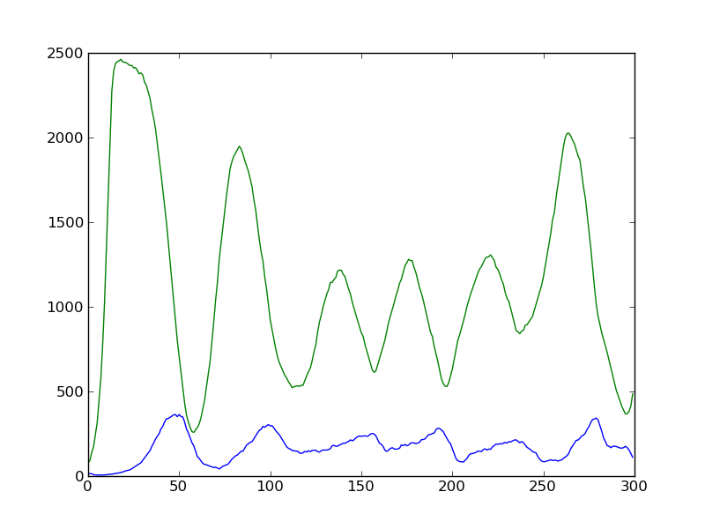
In this Run the values used are:
Predator
Breed time= 8
Starve time= 6
Initial= 15
Prey
Breed time=3
Initial=80
Most Ideal

Slide 17
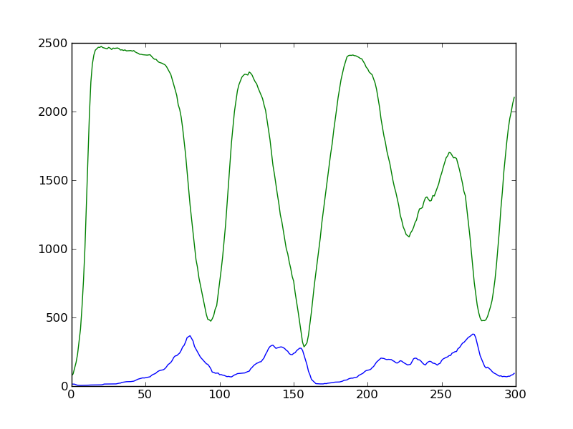
In this Run the values used are:
Predator
Breed time= 16
Starve time= 6
Initial= 15
Prey
Breed time=3
Initial=80
When the predators breed at half the normal rate

Slide 18
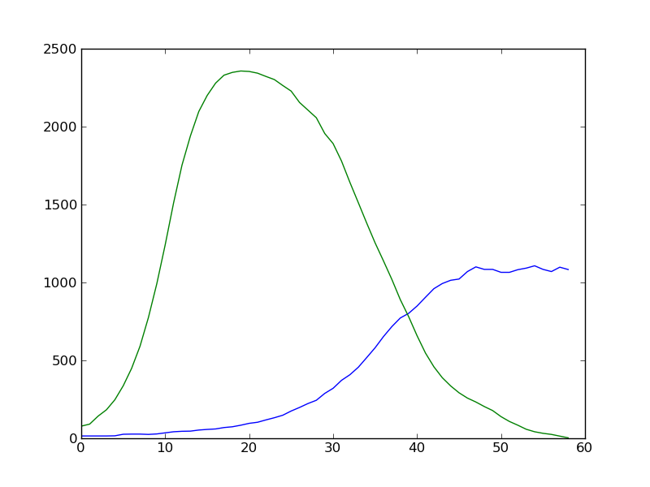
In this Run the values used are:
Predator
Breed time= 8
Starve time=12
Initial= 15
Prey
Breed time=3
Initial=80
When the predators take a longer time to starve

Slide 19
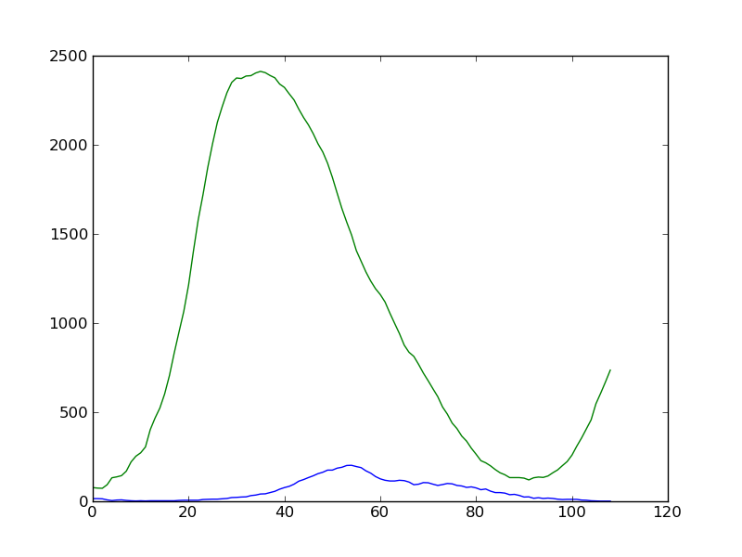
In this Run the values used are:
Predator
Breed time= 8
Starve time= 6
Initial= 15
Prey
Breed time=6
Initial=80
When the prey breed at half the normal rate

Slide 20
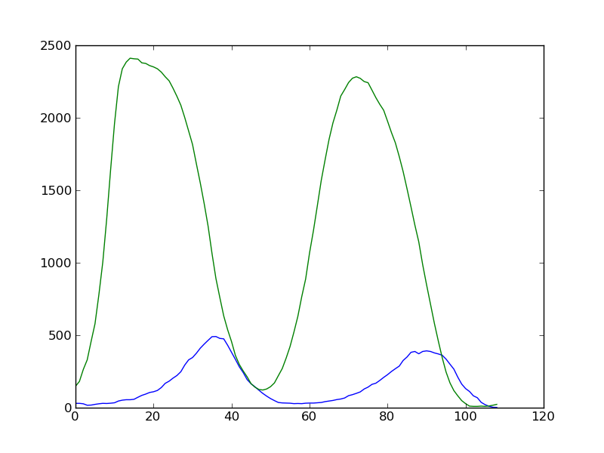
In this Run the values used are:
Predator
Breed time= 8
Starve time= 6
Initial= 30
Prey
Breed time=3
Initial=160
When we double the initial amount of animals on the island

Slide 21
How this simulation could be improved
The procedure of filling the island is inefficient, especially if the island is large and quite full.
What to do if an unoccupied location cannot be found
Prey are animals just like the predators and should have a starvation time along with their own food source
Natural death, an age method could help results be a little more accurate.

Slide 22
Conclusion
There is an Optimal for this data. When the parameters are set to an ideal value. The prey and predators are then capable of living for the most extended amount of time in an environment not accounting for external threats.
If a breed time for predators is too large: the prey will die out
If a breed time of prey is too large: The land/space will become too saturated and predators will grow exponentially in response.
If predators don’t starve: The same result at large prey breeding time.

Slide 23
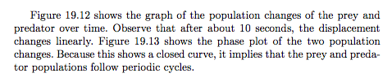
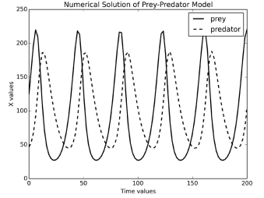

Slide 24
